Slide 1
IA-32 ARCHITECTURE
Computer Organization and Assembly Language
Computer Science Department
National University of Modern Languages, Islamabad
Notes:
IA-32 Architecture refers to systems based on 32-bit processors generally compatible with the Intel Pentium® II processor,

Slide 2
OVERVIEW
Basic Computer Organization
IA-32 Registers
Instruction Execution Cycle
Intel Microprocessors
IA-32 Memory Management

Slide 3
BASIC COMPUTER ORGANIZATION
Since the 1940's, computers have 3 classic components:
  Processor, called also the CPU (Central Processing Unit)
  Memory and Storage Devices
  I/O Devices
Interconnected with one or more buses
Bus consists of
  Data Bus
  Address Bus
  Control Bus
data bus
registers
Processor
(CPU)
Memory
I/O
I/O
Device
Device
#1
#2
ALU
CU
clock
control bus
address bus

Slide 4
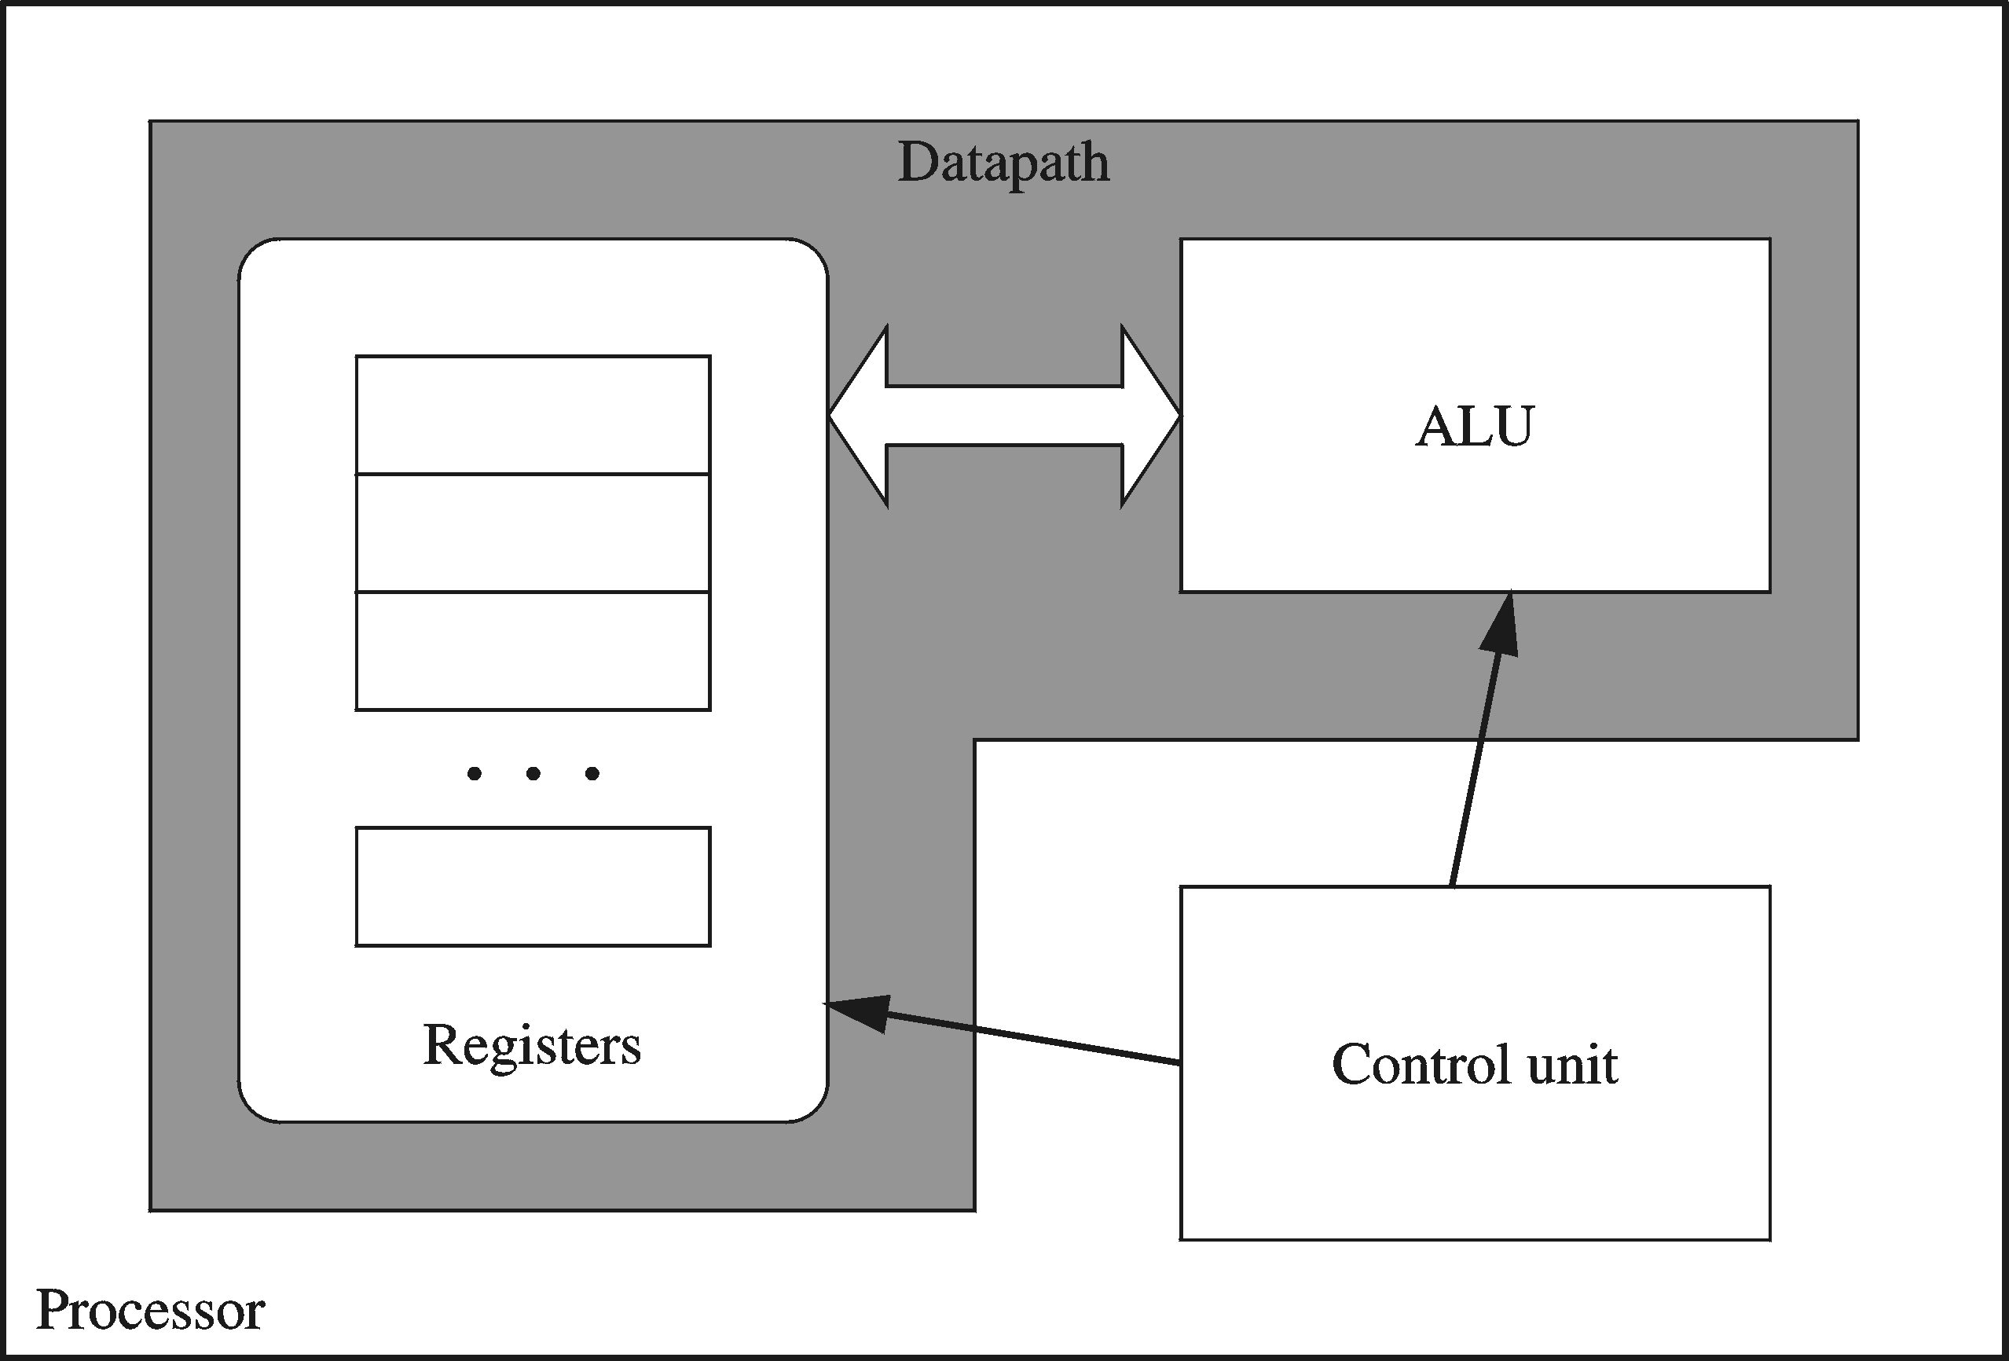
PROCESSOR
Processor consists of
  Datapath
    ALU
    Registers
  Control unit
ALU
  Performs arithmetic
  and logic instructions
Control unit (CU)
  Generates the control signals required to execute instructions
Implementation varies from one processor to another

Slide 5
CLOCK
Synchronizes Processor and Bus operations
Clock cycle = Clock period = 1 / Clock rate
Clock rate = Clock frequency = Cycles per second
  1 Hz = 1 cycle/sec 1 KHz = 10³ cycles/sec
  1 MHz = 10⁶ cycles/sec 1 GHz = 10⁹ cycles/sec
  2 GHz clock has a cycle time = 1/(2×10⁹) = 0.5 nanosecond (ns)
Clock cycles measure the execution of instructions
Cycle 1
Cycle 2
Cycle 3
Notes:
Clock period is defined as the time represented by one clock cycle.

Slide 6
MEMORY
Ordered sequence of bytes
  The sequence number is called the memory address
Byte addressable memory
  Each byte has a unique address
  Supported by almost all processors
Physical address space
  Determined by the address bus width
  Pentium has a 32-bit address bus
    Physical address space = 4GB = 2³² = 4000 000 000 bytes
  Itanium with a 64-bit address bus can support
    Up to 2⁶⁴ bytes of physical address space

Slide 7
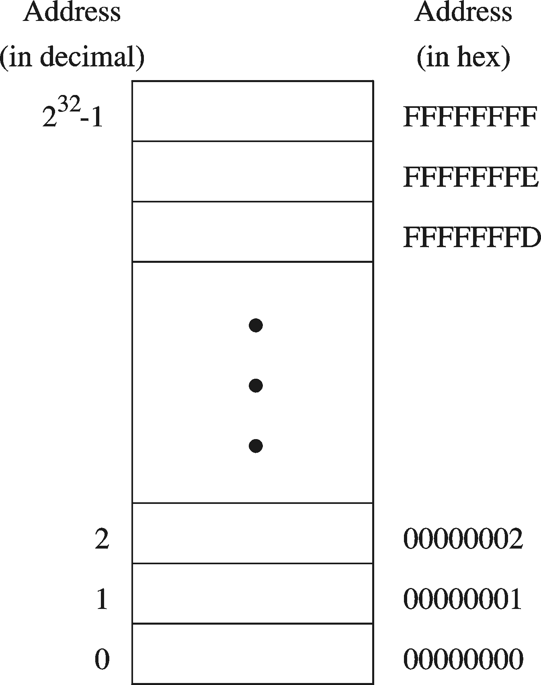
ADDRESS SPACE
Address Space is the set of memory locations (bytes) that can be addressed

Slide 8
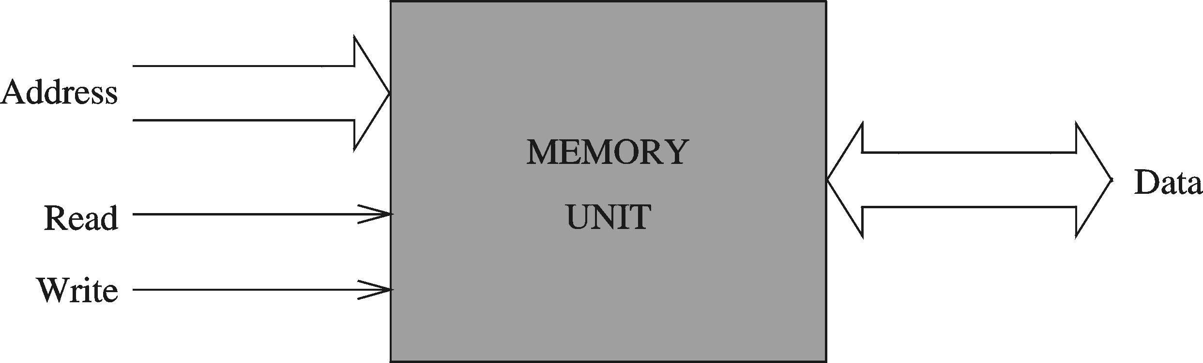
MEMORY UNIT
Address Bus
  Address is placed on the address bus
  Address of location to be read/written
Data Bus
  Data is placed on the data bus
Two Control Signals
  Read
  Write
  Control whether memory should be read or written

Slide 9
THREE BUSES (HISTORY)
Bus Architecture
1) Address Bus:
If I/O, a value between 0000H and FFFFH is issued. (Port Addresses)
If memory, it depends on the architecture:
20-bits (8086/8088) [1 MB]
24-bits (80286/80386SX) [16 MB]
25-bits (80386SL/SLC/EX) [32 MB]
32-bits (80386DX/80486/Pentium) [4 GB]
36-bits (Pentium Pro/II/III) [64 GB]

Slide 10
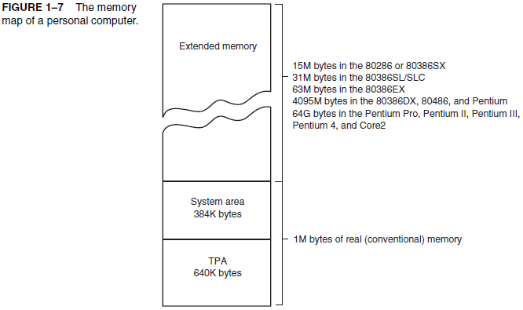
Extended memory contains up to 15-M bytes in the
80286 and 80386 based computers, and up to
4095-M bytes (4 GB) in the 80486, and Pentium
microprocessors, in addition to the first 1-M byte
Of real or conventional memory.
(Hard disk controller)
(Video RAM)
(BIOS + Interrupts + IO.sys)
(MS DOS + Drivers)
Notes:
The IO.SYS contains programs that allow DOS to use the keyboard, video display, printer
The upper 384KB of the first megabyte of memory, located right above conventional memory. Reserved for the system BIOS and device drivers and special uses such as ROM shadowing. Also called expanded memory or reserved memory.
The process of the contents of the ROM being copied to the RAM allowing the computer to access that information quicker is referred to as a BIOS shadow.
Extended area is a windows concept where application program lies.

Slide 11
THREE BUSES (HISTORY)
2) Data Bus:
8-bits (8088)
16-bits (8086/80286/80386SX/SL/SLC/EX)
32-bits (80386DX/80486/Pentium)
64-bits (Pentium Pro/II/III)
3) Control Bus:
Most systems have at least 4 control bus connections (active low).
MRDC’ (Memory ReaD Control), MWRC’ (Memory WRite Control), IORC’ (I/O Read Control), IOWC’ (I/O Write Control). [‘ = Complement]

Slide 12
MEMORY READ AND WRITE CYCLES
Read cycle
  1. Processor places address on the address bus
  2. Processor asserts the memory read control signal
  3. Processor waits for memory to place the data on the data bus
  4. Processor reads the data from the data bus
  Processor drops the memory read signal
Write cycle
  1. Processor places address on the address bus
  Processor asserts the memory write control signal
  Processor places the data on the data bus
  Wait for memory to store the data (wait states for slow memory)
  5. Processor drops the memory write signal
Notes:
The bus cycle is the cycle or time required to make a single read or write transaction

Slide 13
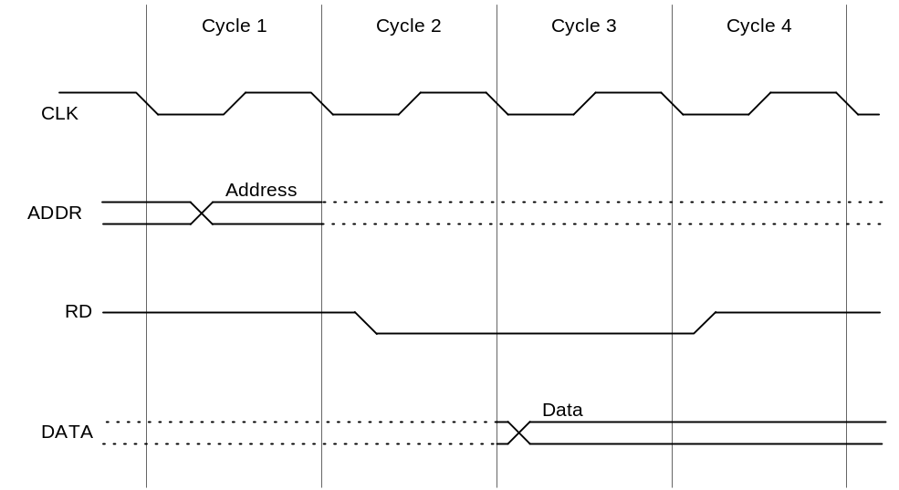
READING FROM MEMORY
Multiple clock cycles are required
Memory responds much more slowly than the CPU
  Address is placed on address bus
  Read Line (RD) goes low, indicating that processor wants to read
  CPU waits (one or more cycles) for memory to respond
  Read Line (RD) goes high, indicating that data is on the data bus

Slide 14
MEMORY DEVICES
ROM = Read-Only Memory
  Stores information permanently (non-volatile)
  Used to store the information required to startup the computer
  Many types: ROM, EPROM, EEPROM, and FLASH
  FLASH memory can be erased electrically in blocks
RAM = Random Access Memory
  Volatile memory: data is lost when device is powered off
  Dynamic RAM (DRAM)
    Inexpensive, used for main memory, must be refreshed constantly
  Static RAM (SRAM)
    Expensive, used for cache memory, faster access, no refresh
Notes:
SRAM is more expensive, but faster and significantly less power hungry (especially idle) than DRAM. It is therefore used where either bandwidth or low power, or both, are principal considerations. SRAM is also easier to control (interface to) and generally more truly random access than modern types of DRAM. Due to a more complex internal structure, SRAM is less dense than DRAM and is therefore not used for high-capacity, low-cost applications such as the main memory in personal computers

Slide 15

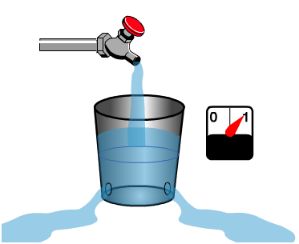
MOST RAM MUST BE RECHARGED CONSTANTLY
Volatile Memory losses contents when power is removed

Slide 16
MEMORY HIERARCHY
Registers
  Fastest storage elements, stores most frequently used data
  General-purpose registers: accessible to the programmer
  Special-purpose registers: used internally by the microprocessor
Cache Memory
  Fast SRAM that stores recently used instructions and data
  Recent processors have 2 and 3 levels
Main Memory (DRAM)
Disk Storage
  Permanent magnetic
  storage for files
registers
cache memory
higher speed, smaller size
lower cost per byte
main memory
disk storage

Slide 17
NEXT ...
Basic Computer Organization
IA-32 Registers
Intel Microprocessors
Instruction Execution Cycle
IA-32 Memory Management

Slide 18
BASIC PROGRAM EXECUTION REGISTERS
Registers are high speed memory inside the CPU
  Eight 32-bit general-purpose registers
  Six 16-bit segment registers
  Processor Status Flags (EFLAGS) and Instruction Pointer (EIP)
32-bit General-Purpose Registers
EAX
EBP
EBX
ESP
ECX
ESI
EDX
EDI
16-bit Segment Registers
EFLAGS
CS
ES
SS
FS
EIP
DS
GS

Slide 19
GENERAL-PURPOSE REGISTERS
Used primarily for arithmetic and data movement
  mov eax, 10 move constant 10 into register eax
Specialized uses of Registers
  EAX – Accumulator register
    Automatically used by multiplication and division instructions
  ECX – Counter register
    Automatically used by LOOP instructions
  ESP – Stack Pointer register
    Used by PUSH and POP instructions, points to top of stack
  ESI and EDI – Source Index and Destination Index register
    Used by string instructions
  EBP – Base Pointer register
    Used to reference parameters and local variables on the stack

Slide 20



ACCESSING PARTS OF REGISTERS
EAX, EBX, ECX, and EDX are 32-bit Extended registers
  Programmers can access their 16-bit and 8-bit parts
  Lower 16-bit of EAX is named AX
  AX is further divided into
    AL = lower 8 bits
    AH = upper 8 bits
ESI, EDI, EBP, ESP have only
16-bit names for lower half

Slide 21
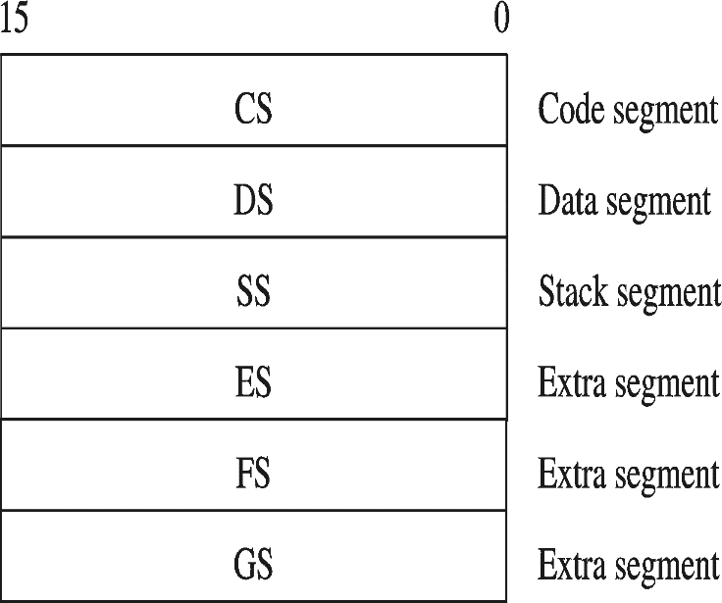
SPECIAL-PURPOSE & SEGMENT REGISTERS
EIP = Extended Instruction Pointer
  Contains address of next instruction to be executed
EFLAGS = Extended Flags Register
  Contains status and control flags
  Each flag is a single binary bit
Six 16-bit Segment Registers
  Support segmented memory
  Six segments accessible at a time
  Segments contain distinct contents
    Code
    Data
    Stack

Slide 22
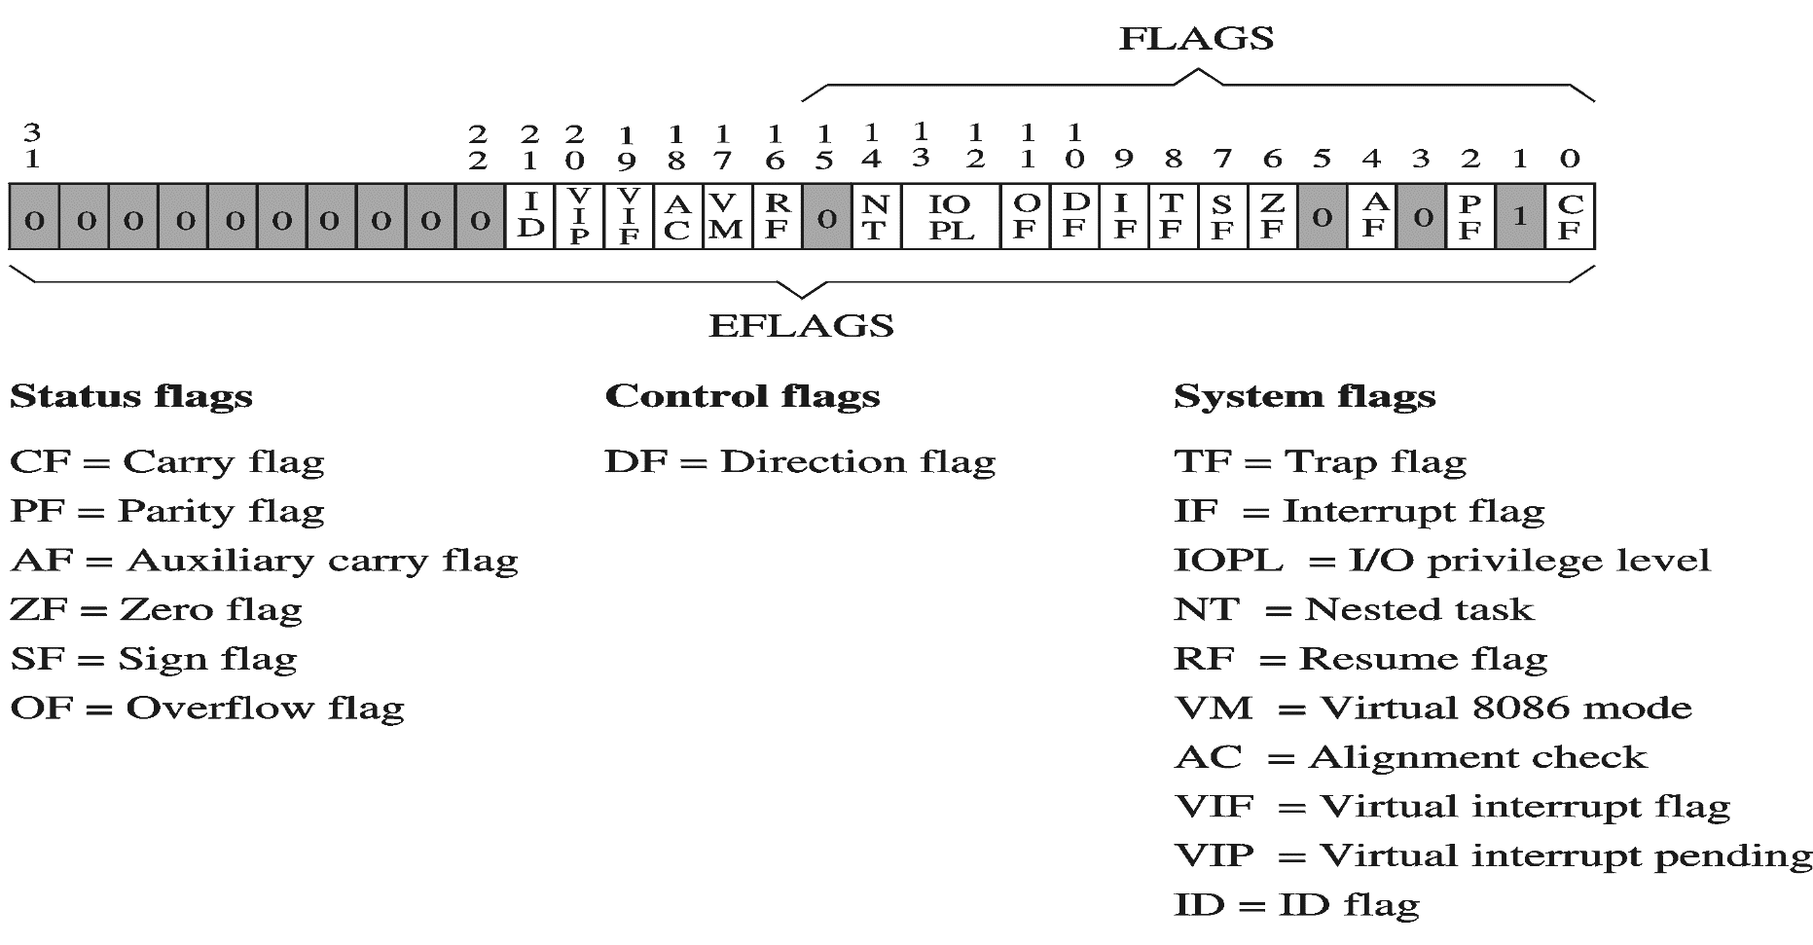
EFLAGS REGISTER
Status Flags
  Status of arithmetic and logical operations
Control and System flags
  Control the CPU operation
Programs can set and clear individual bits in the EFLAGS register

Slide 23
STATUS FLAGS
Carry Flag
  Set when unsigned arithmetic result is out of range
Overflow Flag
  Set when signed arithmetic result is out of range
Sign Flag
  Copy of sign bit, set when result is negative
Zero Flag
  Set when result is zero
Auxiliary Carry Flag
  Set when there is a carry from bit 3 to bit 4
Parity Flag
  Set when parity is even
  Least-significant byte in result contains even number of 1s
Notes:
In computer processors the parity flag indicates if the number of set bits is odd or even in the binary representation of the result of the last operation. It is normally a single bit in a processor status register.
For example, assume a machine where a set parity flag indicates even parity. If the result of the last operation were 26 (11010 in binary), the parity flag would be 0 since the number of set bits is odd. Similarly, if the result were 102 (1100110 in binary) then the parity flag would be 1

Slide 24
NEXT ...
Basic Computer Organization
IA-32 Registers
Instruction Execution Cycle
Intel Microprocessors
IA-32 Memory Management

Slide 25

INSTRUCTION CYCLE
Two steps:
  Fetch
  Execute
Notes:
The execution of a program consists of the sequential execution of instructions. Each instruction is executed during an instruction cycle

Slide 26
FETCH CYCLE
Program Counter (PC) holds address of next instruction to fetch
Processor fetches instruction from memory location pointed to by PC
Increment PC
  Unless told otherwise
Instruction loaded into Instruction Register (IR)
Processor interprets instruction and performs required actions

Slide 27
EXECUTE CYCLE
Processor-memory
  data transfer between CPU and main memory
Processor I/O
  Data transfer between CPU and I/O module
Data processing
  Some arithmetic or logical operation on data
Control
  Alteration of sequence of operations
  e.g. jump
Combination of above

Slide 28
INSTRUCTION EXECUTE CYCLE
Instruction
Fetch
Obtain instruction from program storage
Instruction
Decode
Determine required actions and instruction size
Operand
Fetch
Infinite Cycle
Locate and obtain operand data
Execute
Compute result value and status
Writeback
Result
Deposit results in storage for later use

Slide 29
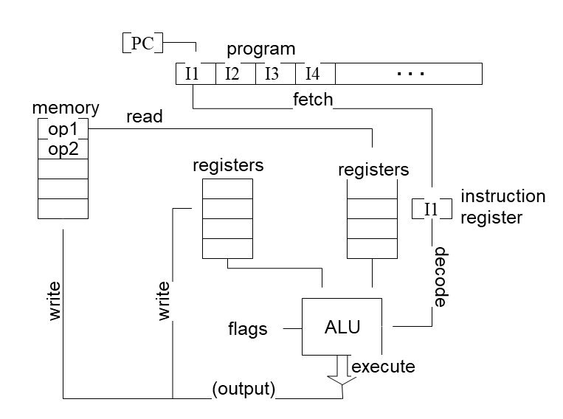
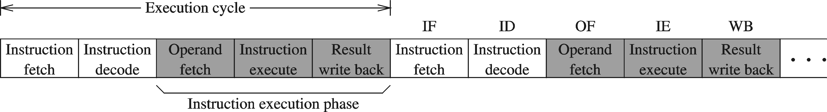
INSTRUCTION EXECUTION CYCLE – CONT'D
Instruction Fetch
Instruction Decode
Operand Fetch
Execute
Result Writeback

Slide 30
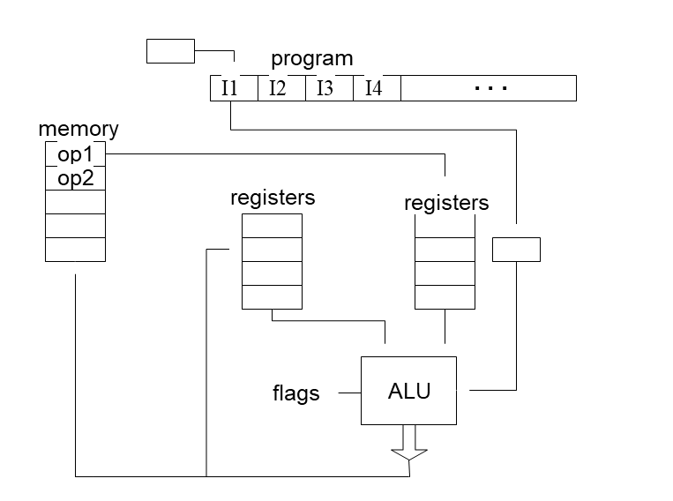
INSTRUCTION EXECUTION CYCLE – CONT'D
Instruction Fetch
Instruction Decode
Operand Fetch
Execute
Result Writeback

Slide 31
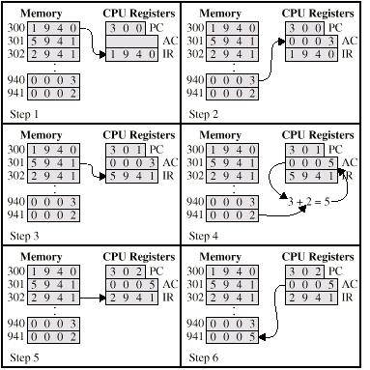
EXAMPLE OF PROGRAM EXECUTION

Slide 32
NEXT ...
Basic Computer Organization
IA-32 Registers
Instruction Execution Cycle
Intel Microprocessors
IA-32 Memory Management

Slide 33
INTEL MICROPROCESSORS
Intel introduced the 8086 microprocessor in 1979
8086, 8087, 8088, and 80186 processors
  16-bit processors with 16-bit registers
  16-bit data bus and 20-bit address bus
    Physical address space = 2²⁰ bytes = 1 MB
  8087 Floating-Point co-processor
  Uses segmentation and real-address mode to address memory
    Each segment can address 2¹⁶ bytes = 64 KB
  8088 is a less expensive version of 8086
    Uses an 8-bit data bus
  80186 is a faster version of 8086
Notes:
Every x86 cpu starts in real mode and the OS must switch to protected mode. In 'real mode' program uses BIOS subroutines along with OS subroutines (64KB seg) whereas a 'protected mode‘ (different Seg size) the OS can use features like paging and virtual memory (flat mode).

Slide 34
Extended memory contains up to 15-M bytes in the
80286 and 80386 based computers, and up to
4095-M bytes (4 GB) in the 80486, and Pentium
microprocessors, in addition to the first 1-M byte
Of real or conventional memory.
(Hard disk controller)
(Video RAM)
(BIOS + Interrupts + IO.sys)
(MS DOS + Drivers)
Notes:
The IO.SYS contains programs that allow DOS to use the keyboard, video display, printer
The upper 384KB of the first megabyte of memory, located right above conventional memory. Reserved for the system BIOS and device drivers and special uses such as ROM shadowing. Also called expanded memory or reserved memory.
The process of the contents of the ROM being copied to the RAM allowing the computer to access that information quicker is referred to as a BIOS shadow.
Extended area is a windows concept where application program lies.

Slide 35
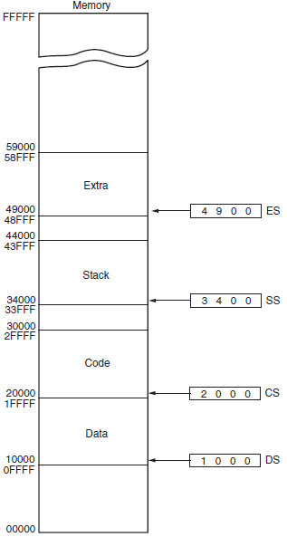
MEMORY SEGMENTS OF THE 8086

Slide 36
INTEL 80286 AND 80386 PROCESSORS
80286 was introduced in 1982
  24-bit address bus ⇒ 2²⁴ bytes = 16 MB address space
  Introduced protected mode
    Segmentation in protected mode is different from the real mode
80386 was introduced in 1985
  First 32-bit processor with 32-bit general-purpose registers
  First processor to define the IA-32 architecture
  32-bit data bus and 32-bit address bus
  2³² bytes ⇒ 4 GB address space
  Introduced paging, virtual memory, and the flat memory model
    Segmentation can be turned off

Slide 37
INTEL 80486 AND PENTIUM PROCESSORS
80486 was introduced 1989
  Improved version of Intel 80386
  On-chip Floating-Point unit (DX versions)
  On-chip unified Instruction/Data Cache (8 KB)
  Uses Pipelining: can execute up to 1 instruction per clock cycle
Pentium (80586) was introduced in 1993
  Wider 64-bit data bus, but address bus is still 32 bits
  Two execution pipelines: U-pipe and V-pipe
    Superscalar performance: can execute 2 instructions per clock cycle
  Separate 8 KB instruction and 8 KB data caches
  MMX instructions (later models) for multimedia applications
Notes:
MMX-Multimedia Instructions
The U-pipe can execute any instruction in the Intel(R) architecture while the V-pipe can execute only simple instructions
A superscalar processor is a CPU that implements a form of parallelism called instruction-level parallelism within a single processor.

Slide 38
INTEL P6 PROCESSOR FAMILY
P6 Processor Family: Pentium Pro, Pentium II and III
Pentium Pro was introduced in 1995
  Three-way superscalar: can execute 3 instructions per clock cycle
  36-bit address bus ⇒ up to 64 GB of physical address space
  Introduced dynamic execution
    Out-of-order and speculative execution
  Integrates a 256 KB second level L2 cache on-chip
Pentium II was introduced in 1997
  Added MMX instructions (already introduced on Pentium MMX)
Pentium III was introduced in 1999
  Added SSE instructions and eight new 128-bit XMM registers
Notes:
SIMD(Single instruction multiple data)
SSE-Streaming SIMD extension(handle compound operands)
Eight 128-bit registers are available for holding these operands. They operate on the four corresponding pairs of 32-bit operands in the 128 bit compound source and destination operands and place the four individual results in the 128 bit destination location.

Slide 39
EVOLUTION OF INTEL MICROPROCESSORS

Slide 40
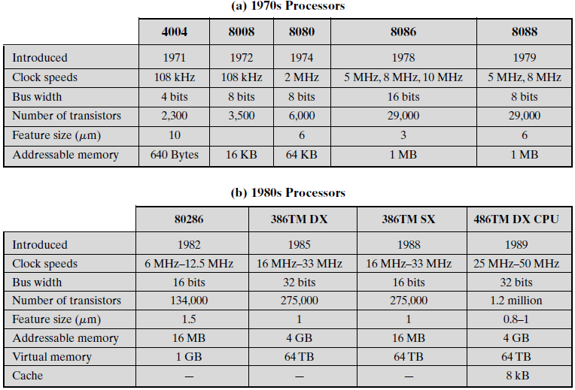

Slide 41
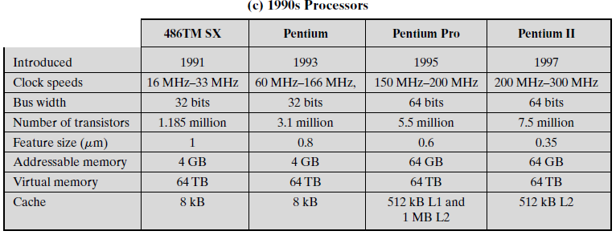

Slide 42
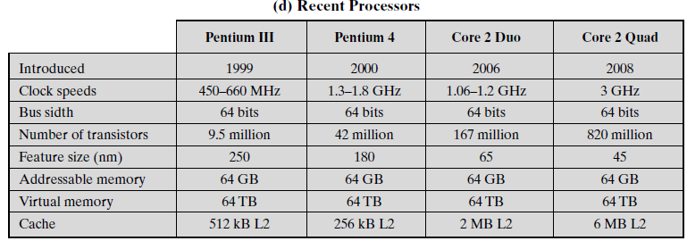

Slide 43
CISC AND RISC
CISC – Complex Instruction Set Computer
  Large and complex instruction set
  Variable width instructions
  Requires microcode interpreter
    Each instruction is decoded into a sequence of micro-operations
  Example: Intel x86 family
RISC – Reduced Instruction Set Computer
  Small and simple instruction set
  All instructions have the same width
  Simpler instruction formats and addressing modes
  Decoded and executed directly by hardware
  Examples: ARM, MIPS, PowerPC, SPARC, etc.

Slide 44
POST-RISC ARCHITECTURE
Modern processors have developed further from the basic ideas behind RISC architecture
  exploit more instruction level parallelism
Characteristics:
  parallel instruction execution (superscalar)
  deep pipeline (super-pipelined)
  advanced branch prediction
  out-of-order instruction execution
  register renaming
  extended instruction set

